Slide 1
近期文章分享
南方科技大学，计算机科学与工程系
计算语言学与意识科学实验室
Computational Linguistics and Consciousness Science Lab
2024年11月8日
徐炀

Slide 2
Papers
A.F. Badalamenti et al.,
Lawful Systems Dynamics in How Poets Choose Their Words (1994)
Poisson Evolution in Word Selection (1994)
Bao et al., (Author of Fast-DetectGPT)
White-Box Text Detectors using Proprietary LLMs: A Probability Distribution Estimation (PDE) Approach
Nature watermark paper

Slide 3
A.F. Badalamenti et al.: Paper A +B
Paper A: Lawful Systems Dynamics in How Poets Choose Their Words (1994) Behavioral Science
The emergence of new words is a Poisson process
Data: seven poets
Two measures
waiting time between the invocation of new words
information entropy of word

Slide 4
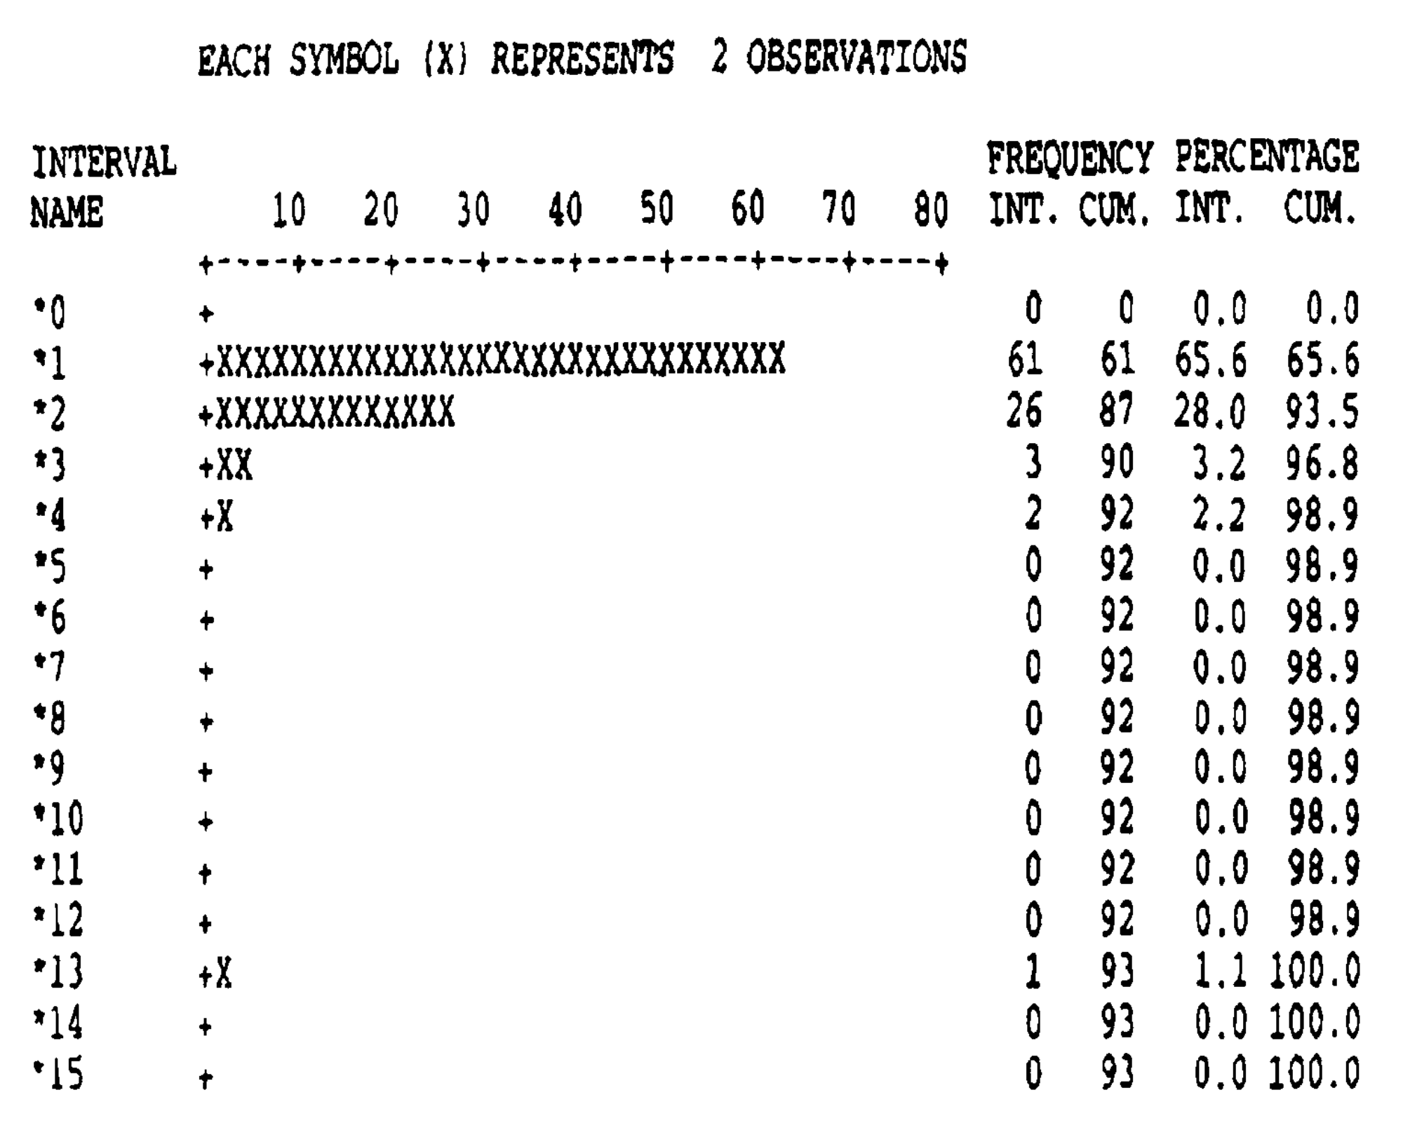
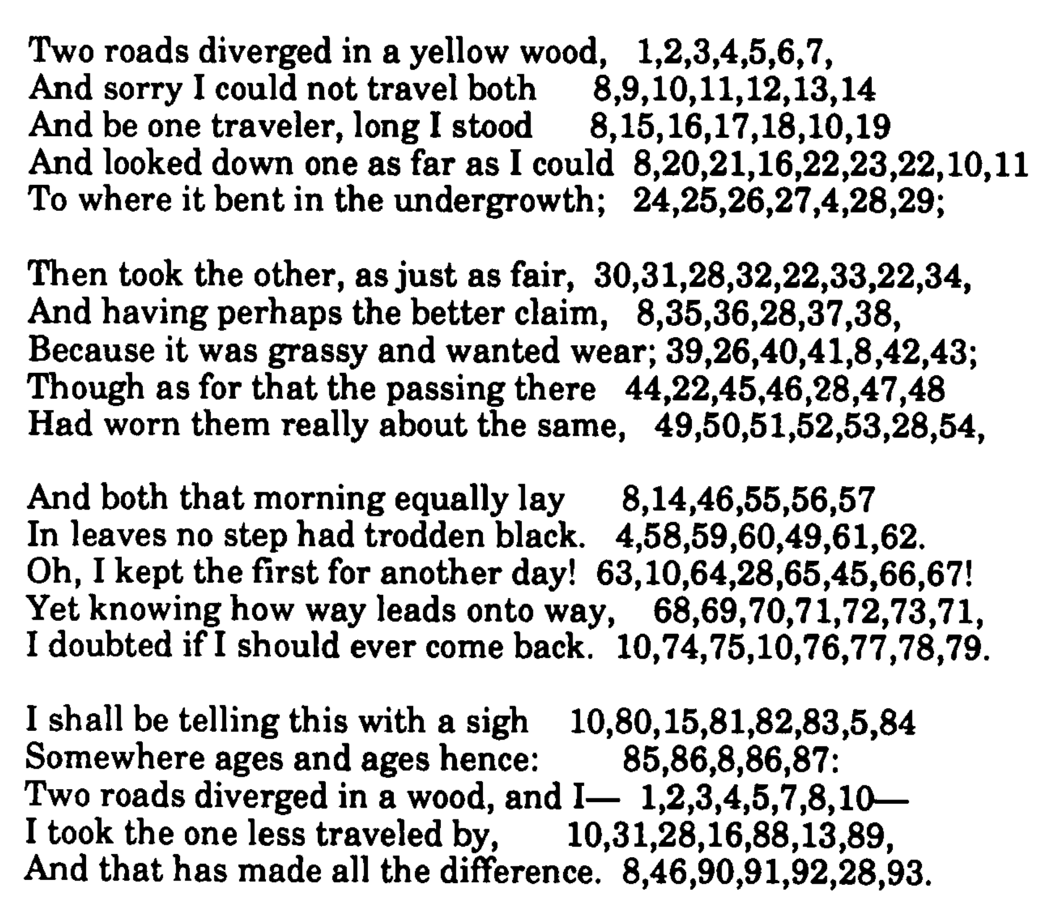
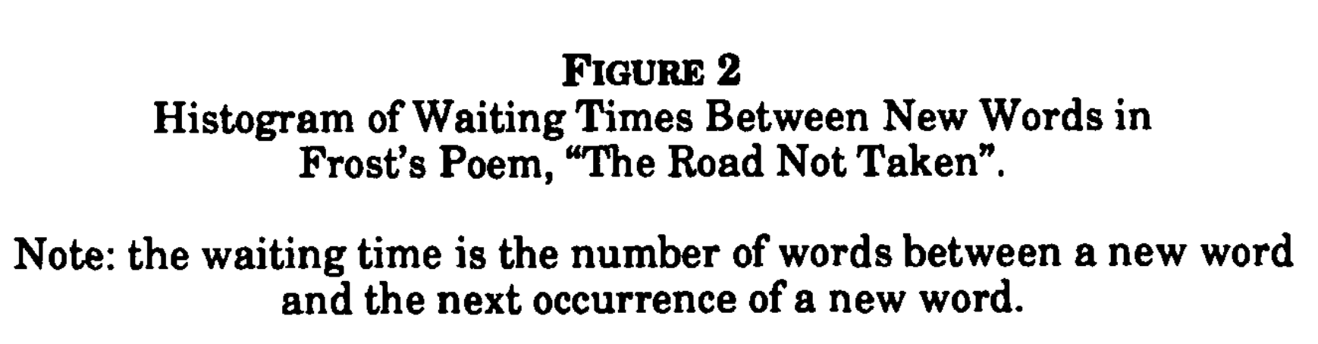
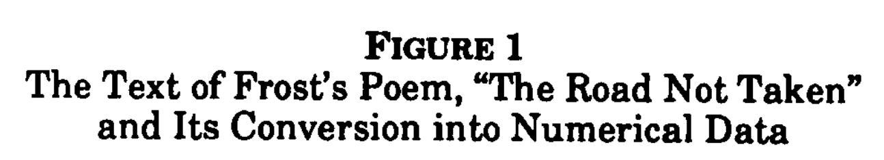
Q1: Temporal property of new words?

Slide 5
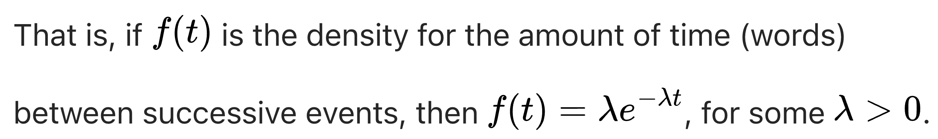
Poisson = Negative Exponential
Page 67:
“A Poisson model characterizes the instantaneous probability that an event, here a new word, will occur.”
The chief signature of a Poisson process is that the distribution of waiting times between successive events is negative exponential.
(between a new word and the next new word)

Slide 6
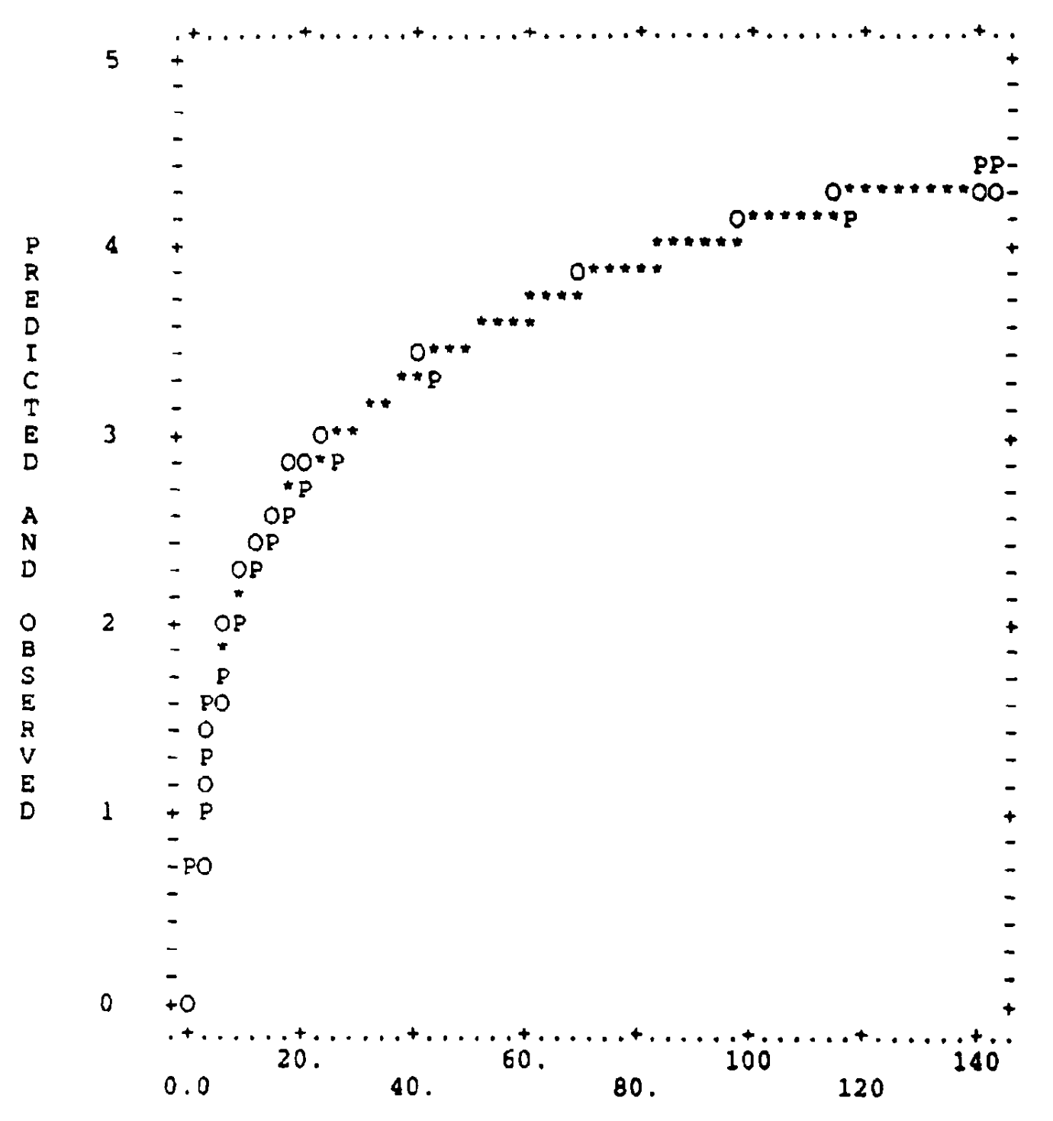
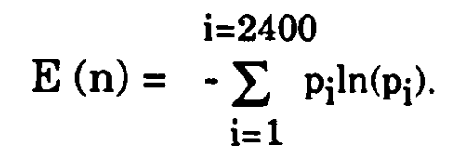
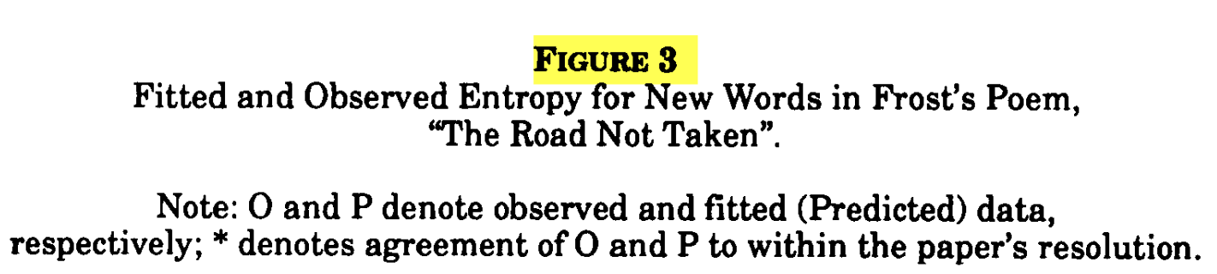
Q2: How does the variety of words grow?
Define entropy using unigram probabilities
Entropy
Word position

Slide 7
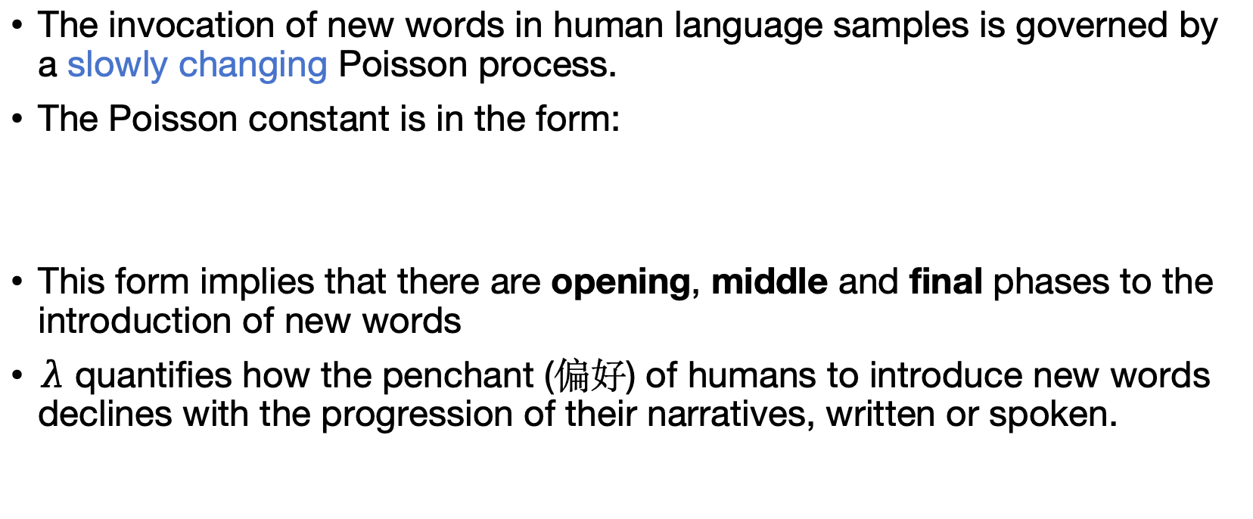
Paper B: Poisson Evolution in Word Selection
The invocation of new words in human language samples is governed by a slowly changing Poisson process.
The Poisson constant is in the form:
This form implies that there are opening, middle and final phases to the introduction of new words
$λ$ quantifies how the penchant (偏好) of humans to introduce new words declines with the progression of their narratives, written or spoken.

Slide 8
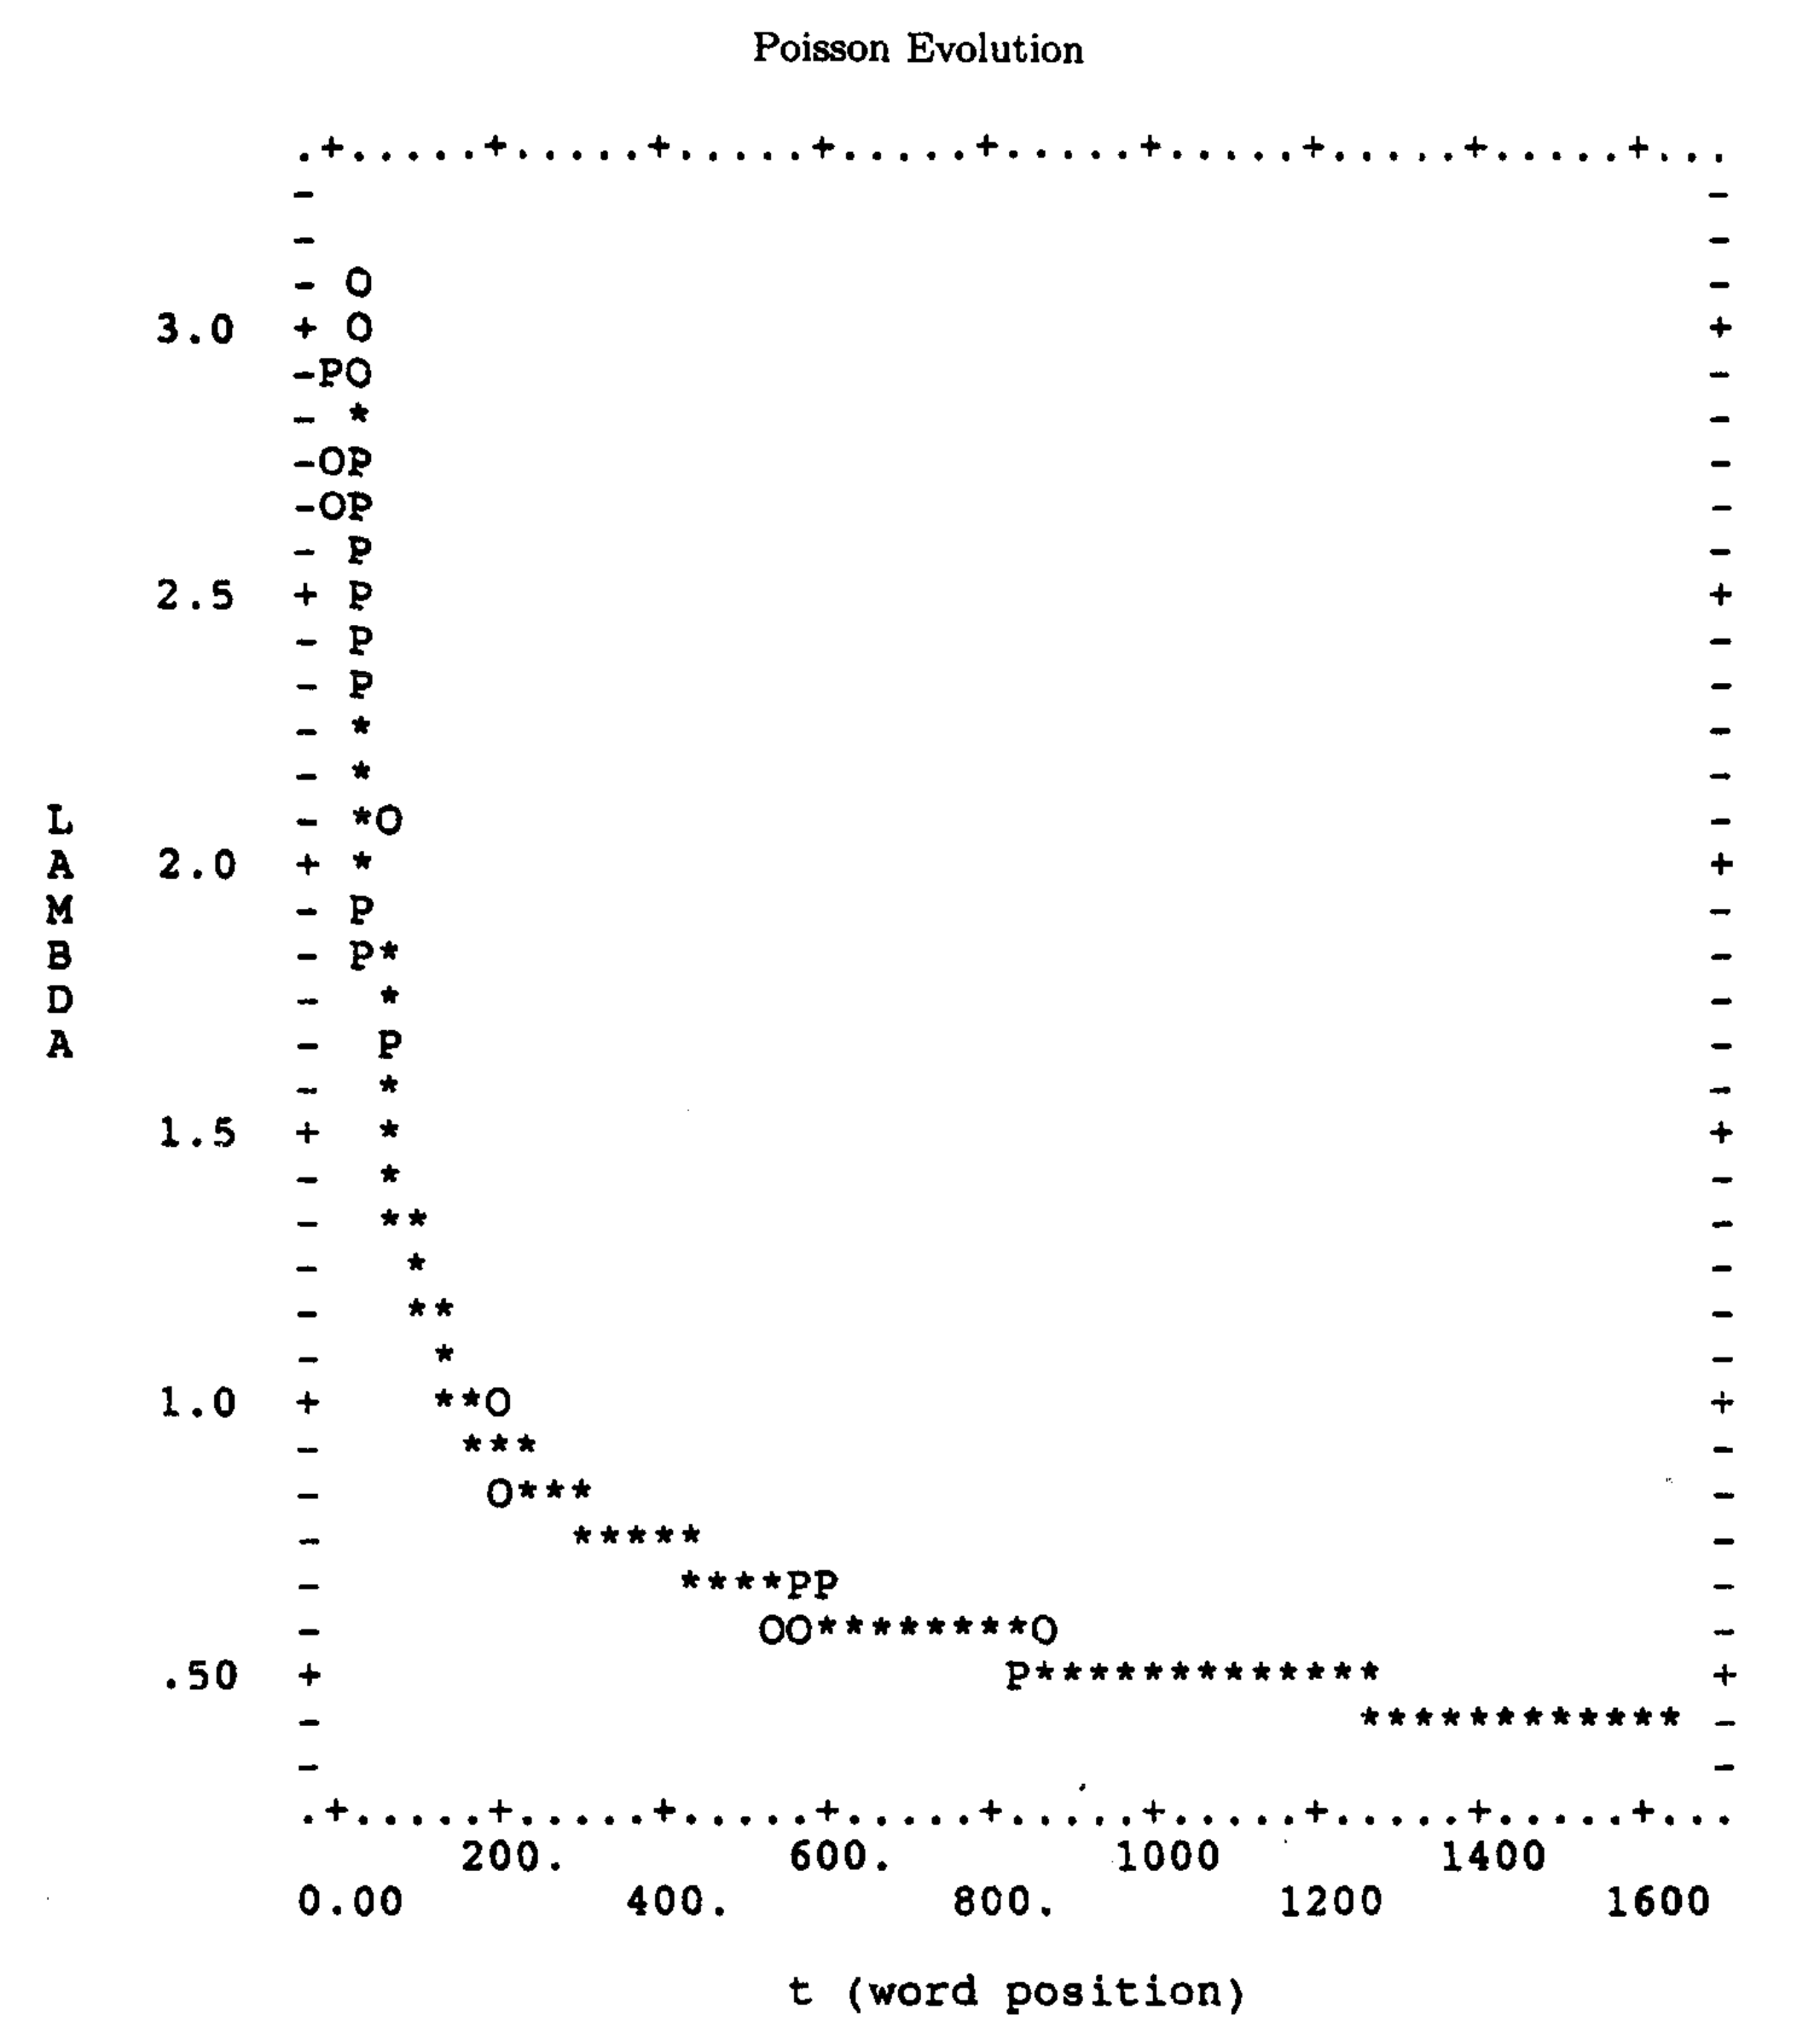

Poisson Evolution: $λ(t)$ evolves over time

Slide 9
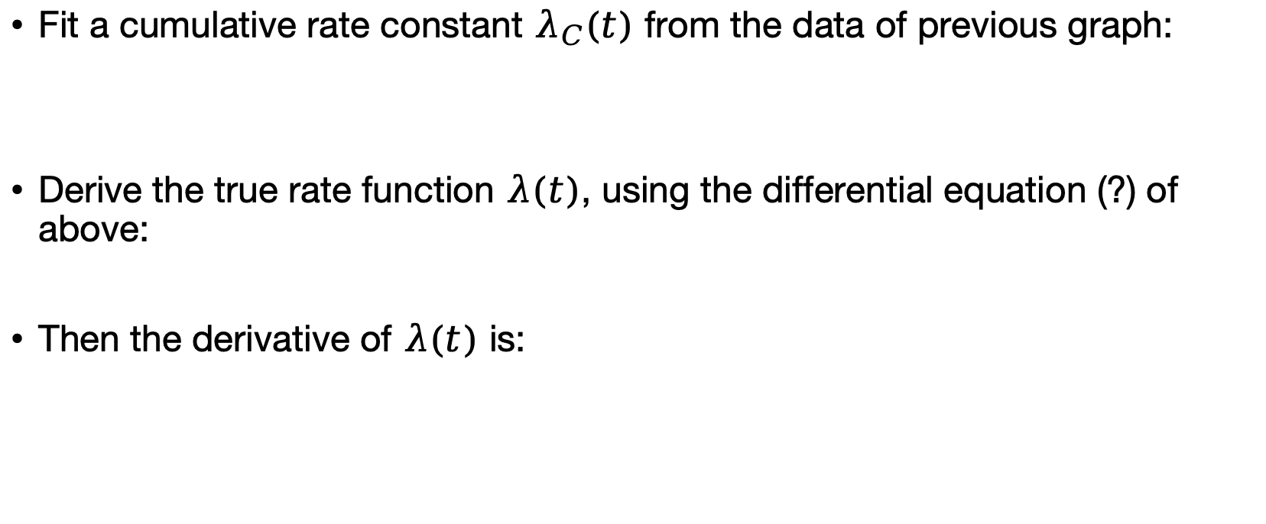
Fit Poisson constants
Fit a cumulative rate constant $λ_{C}(t)$ from the data of previous graph:
Derive the true rate function $λ(t)$, using the differential equation (?) of above:
Then the derivative of $λ(t)$ is:

Slide 10
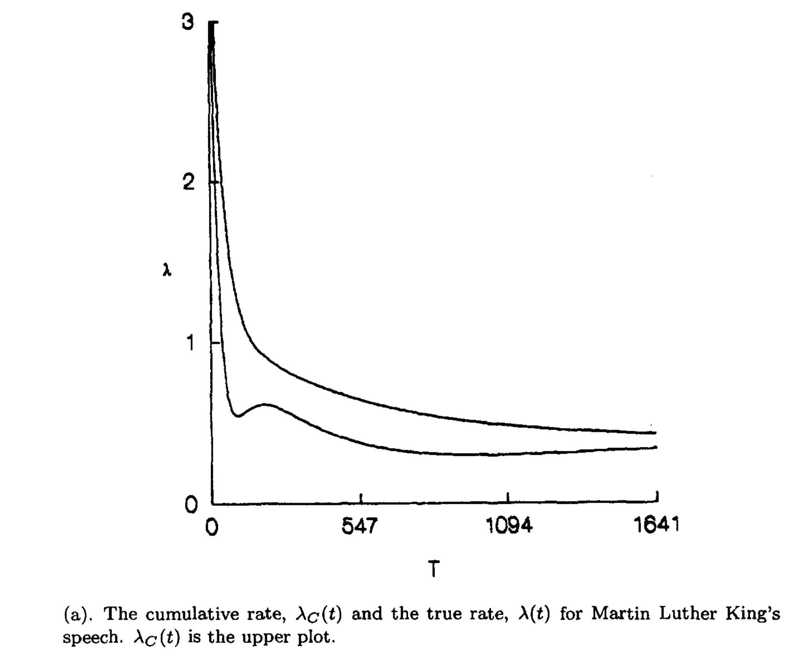
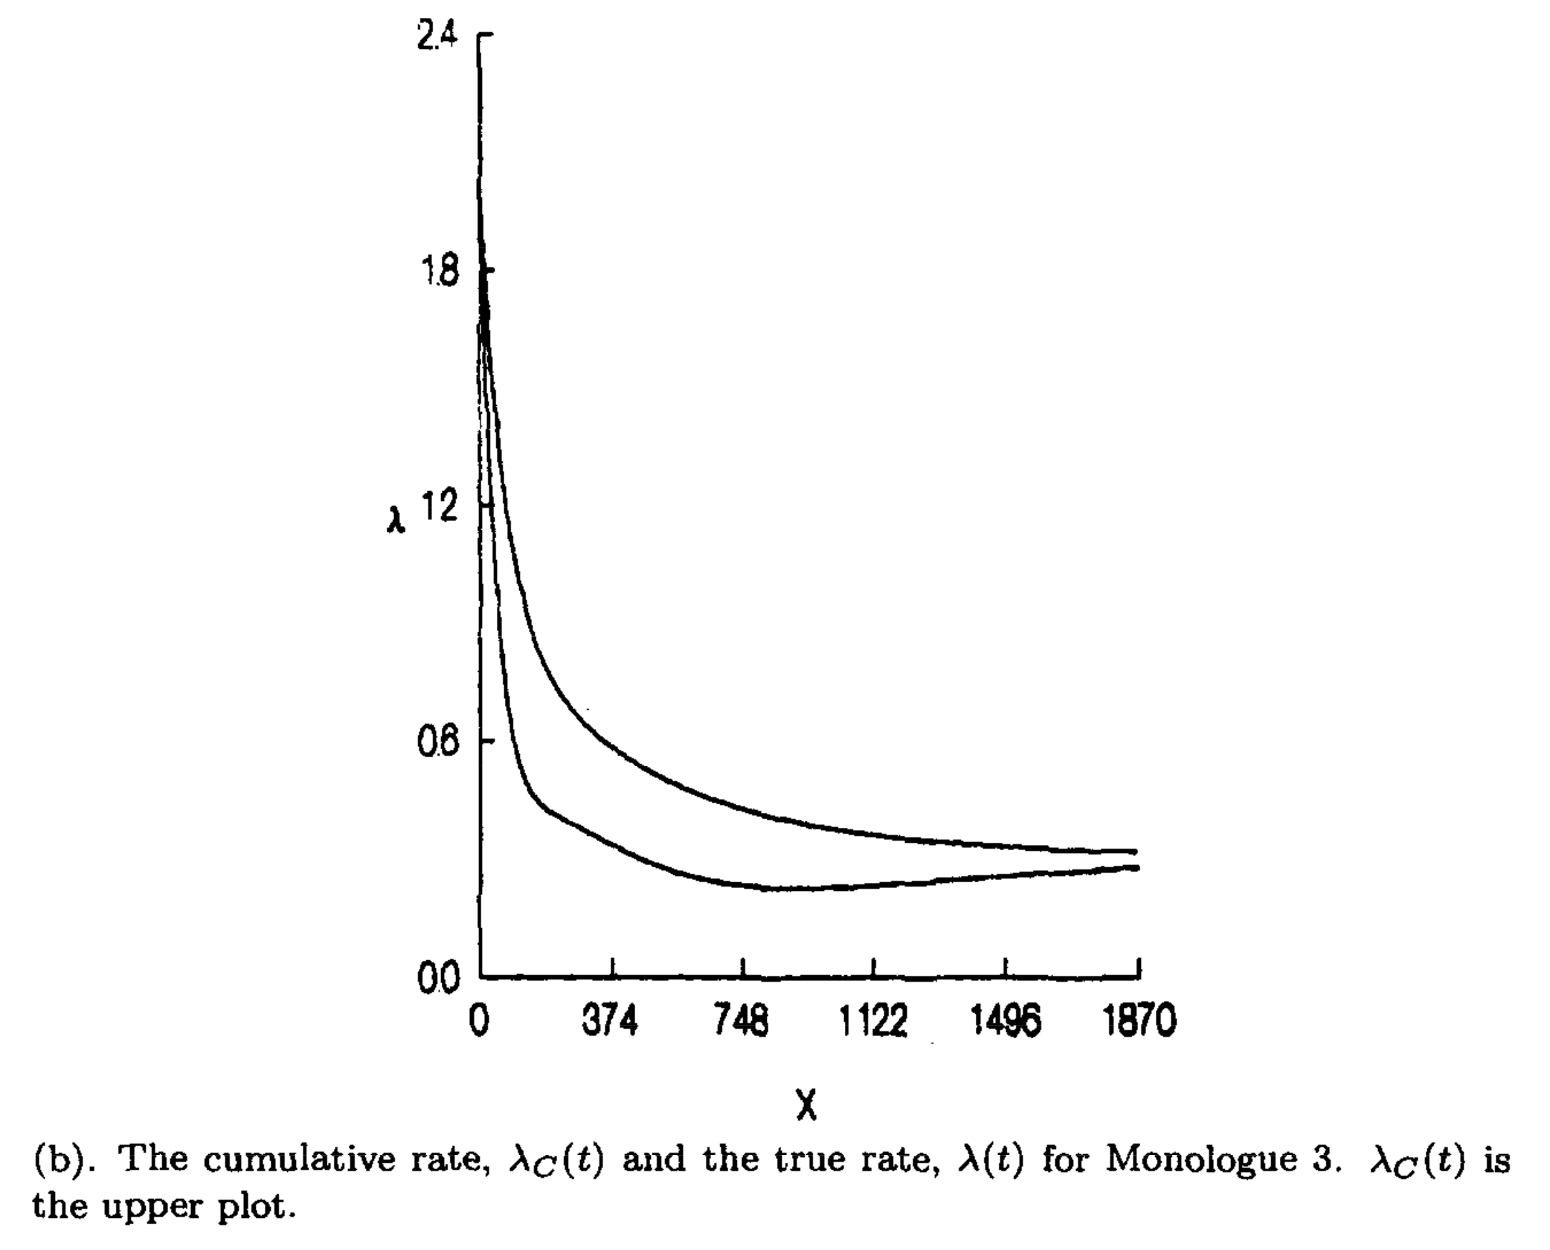
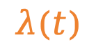
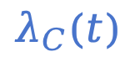
Phases of new word generation
$$λ_{C}(t)$$
$$λ(t)$$

Slide 11
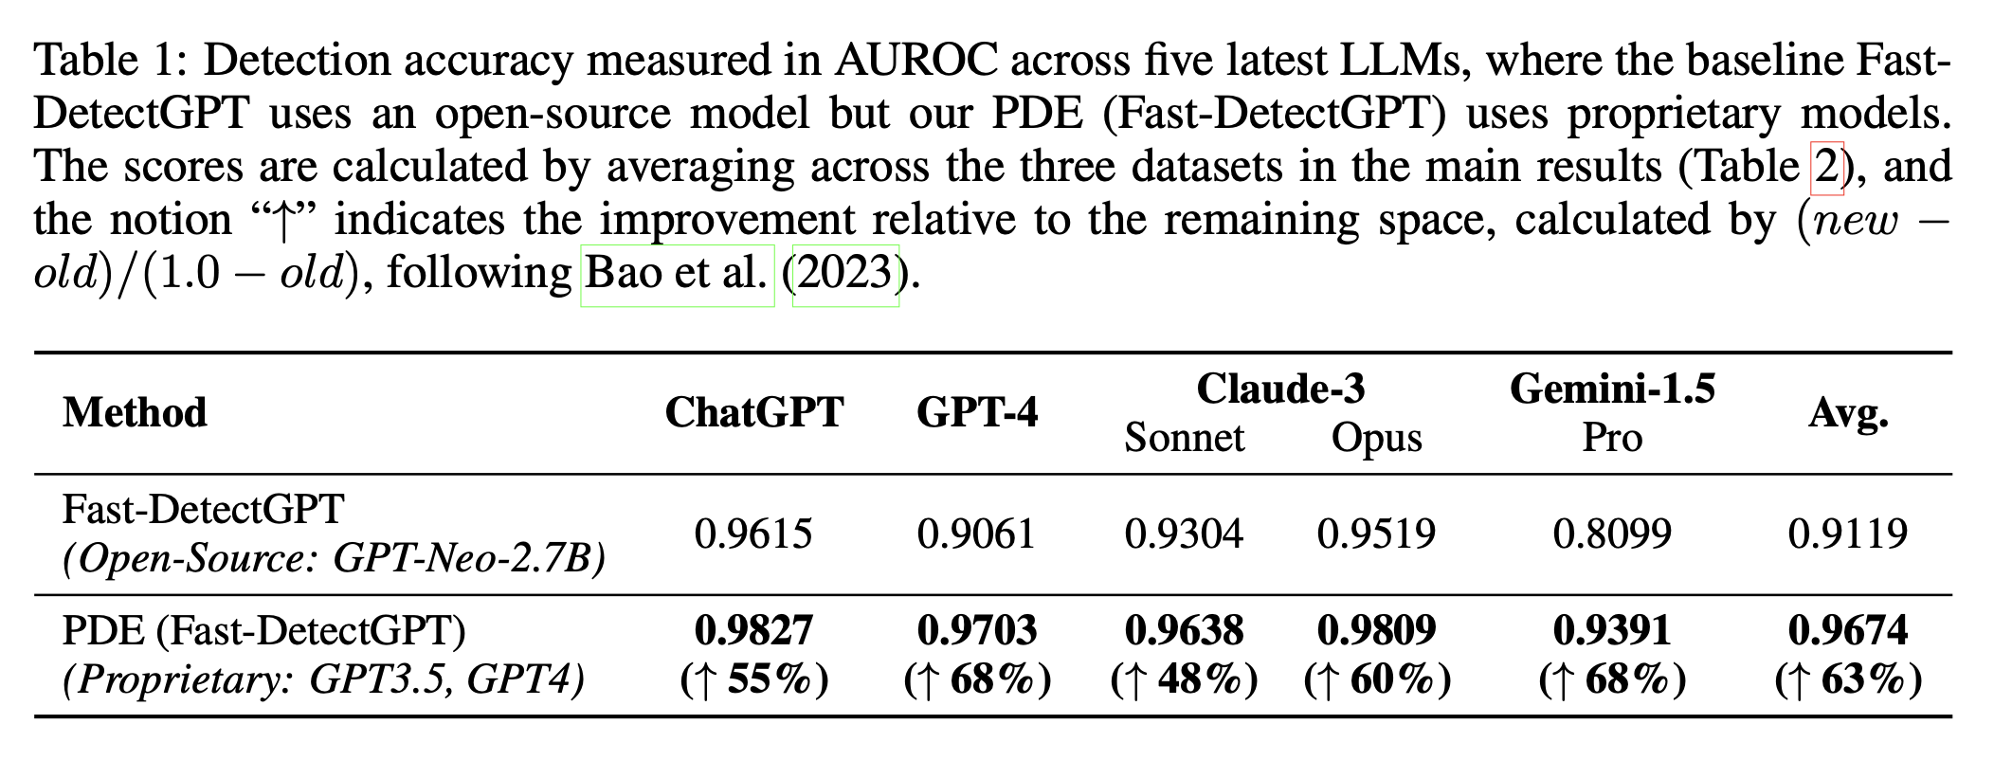
Bao et al.: PDF Approach for Text Detection
Propose Probability Distribution Estimation (PDE) to enable existing white-box methods to proprietary models
Xsum, Writing, PubMed

Slide 12
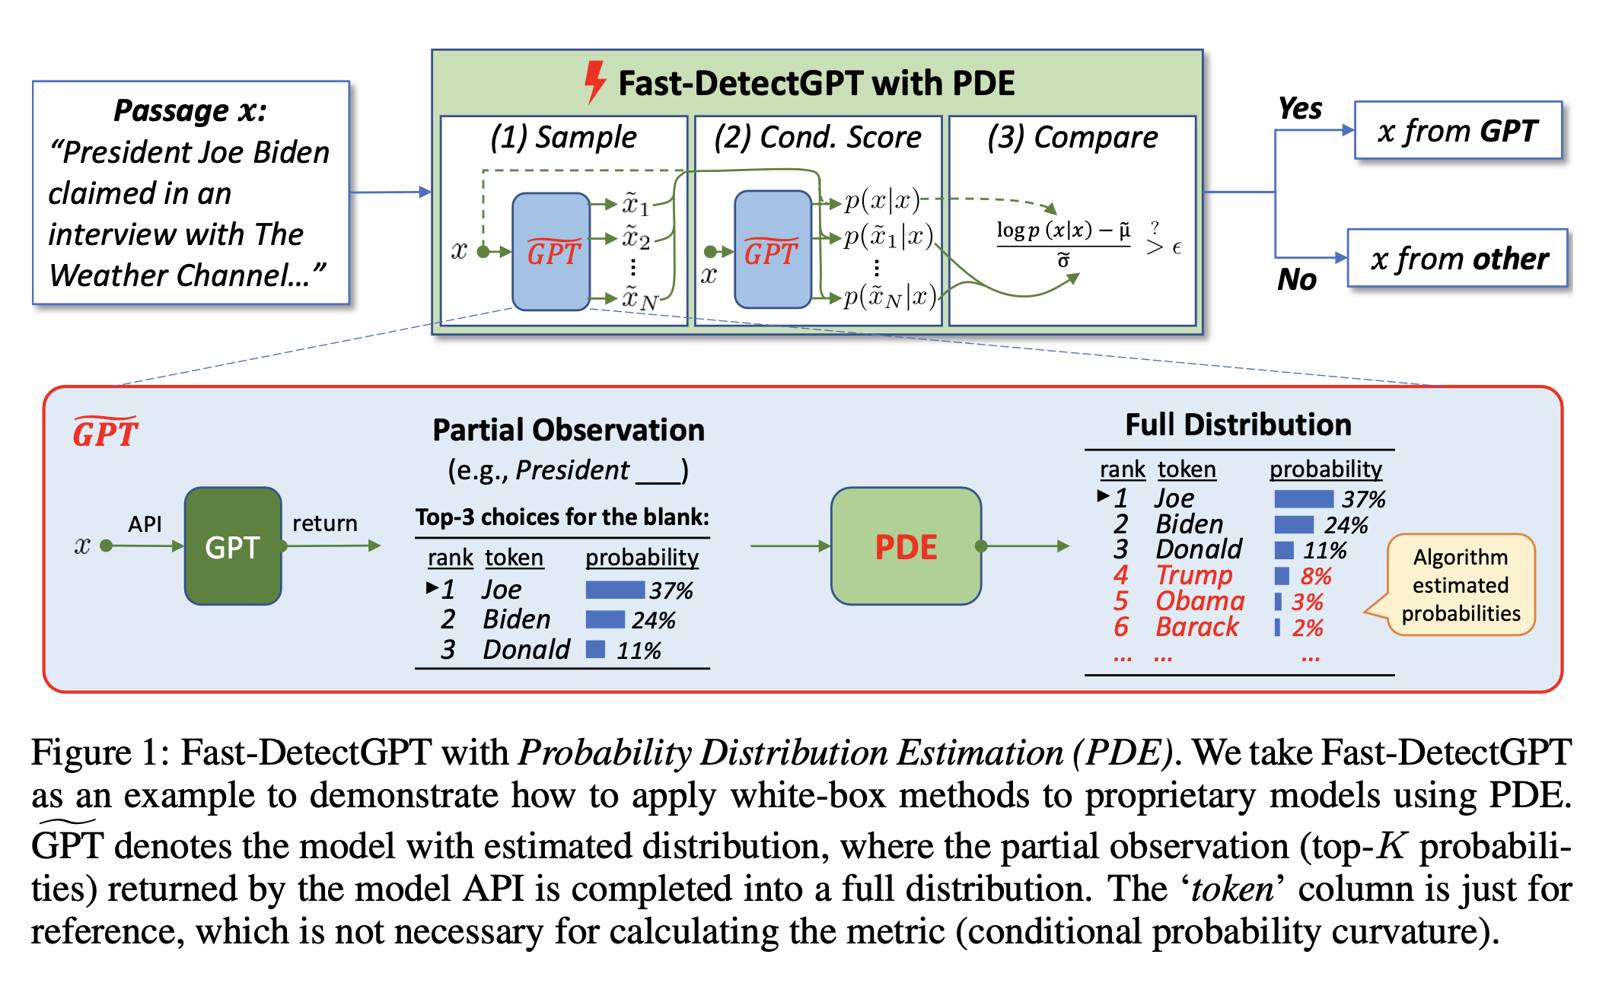
Overview

Slide 13
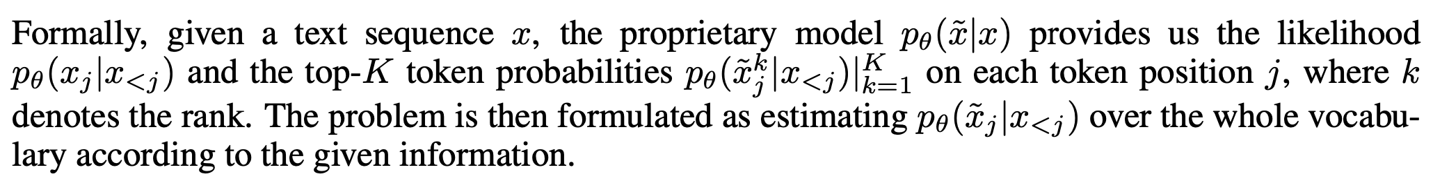
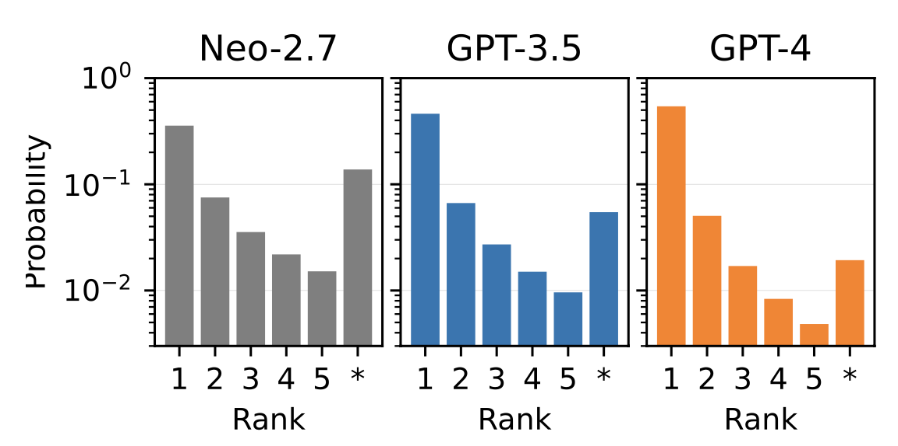
Probability Distribution Estimation (PDE)
The probability distribution follows a decaying pattern, where the larger models have a higher top-1 probability and a bigger decay factor

Slide 14
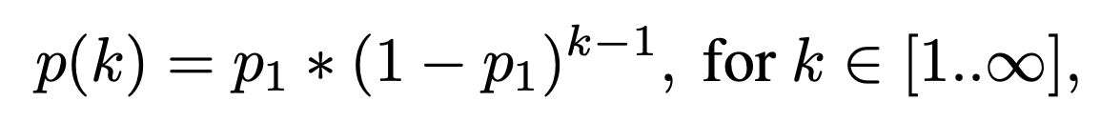
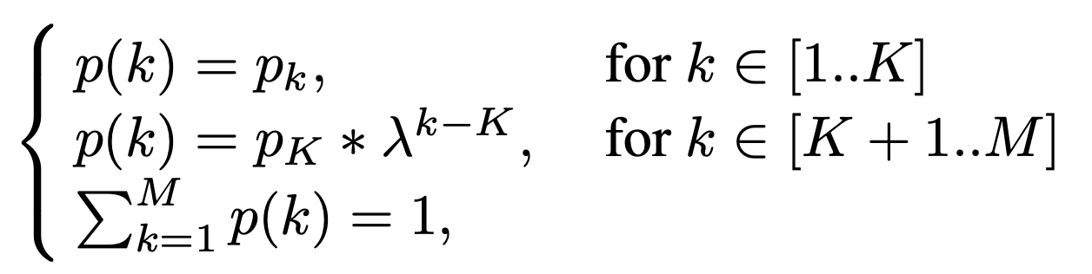
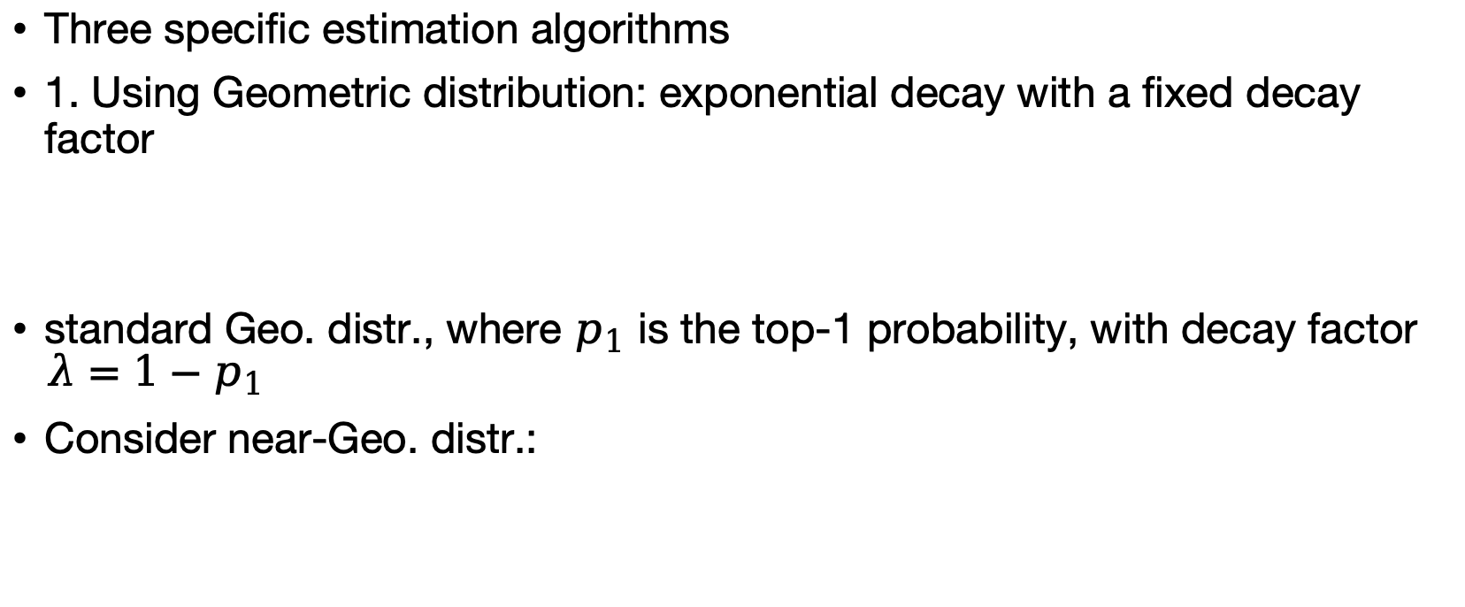
Probability Distribution Estimation (PDE)
Three specific estimation algorithms
1. Using Geometric distribution: exponential decay with a fixed decay factor
standard Geo. distr., where $p_{1}$ is the top-1 probability, with decay factor $λ=1−p_{1}$
Consider near-Geo. distr.:
decay factor $λ$ is learned iteratively

Slide 15
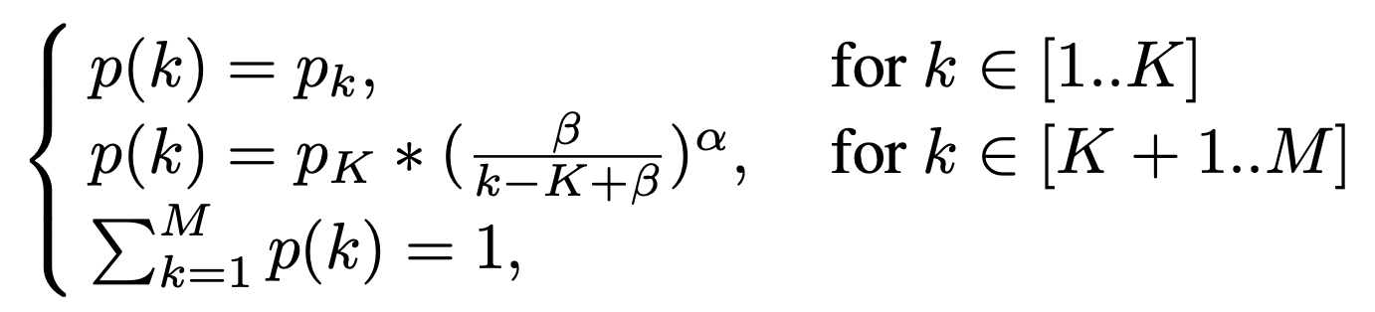
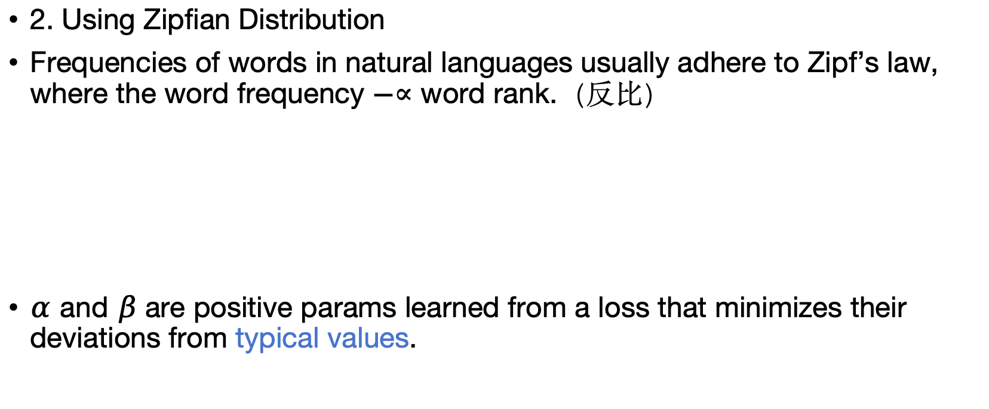
Probability Distribution Estimation (PDE)
2. Using Zipfian Distribution
Frequencies of words in natural languages usually adhere to Zipf’s law, where the word frequency $−∝$ word rank.（反比）
$α$ and $β$ are positive params learned from a loss that minimizes their deviations from typical values.

Slide 16
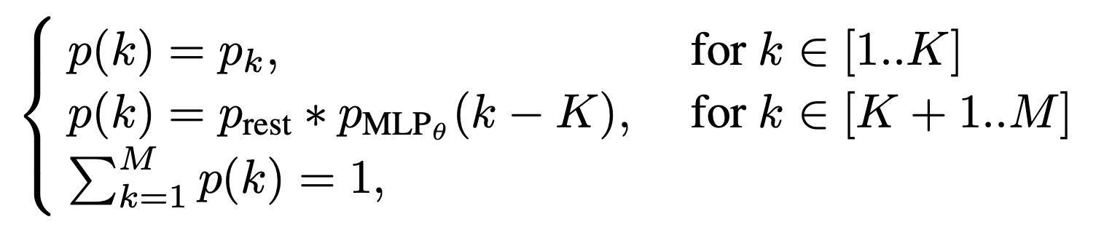
Probability Distribution Estimation (PDE)
3. Using a Multi-Layer Perceptron (MLP) model, which accepts the top-K probabilities and predicts the probabilities for the rest of the ranks.

Slide 17
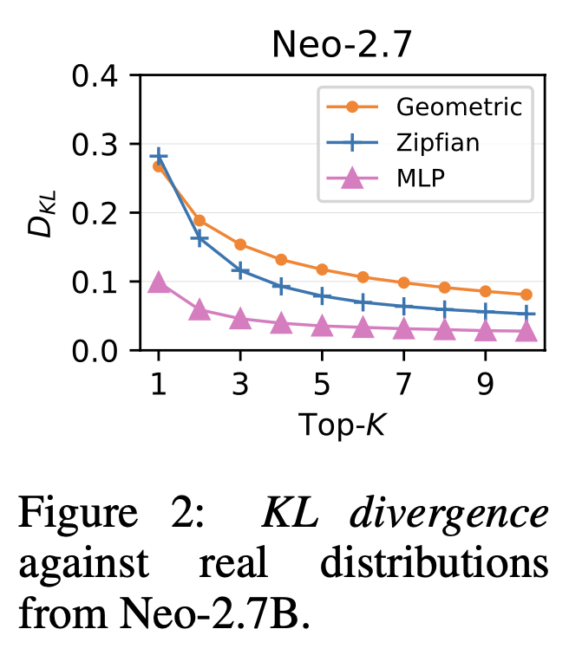
PDE Outcomes
MLP is closest to real distr.

Slide 18
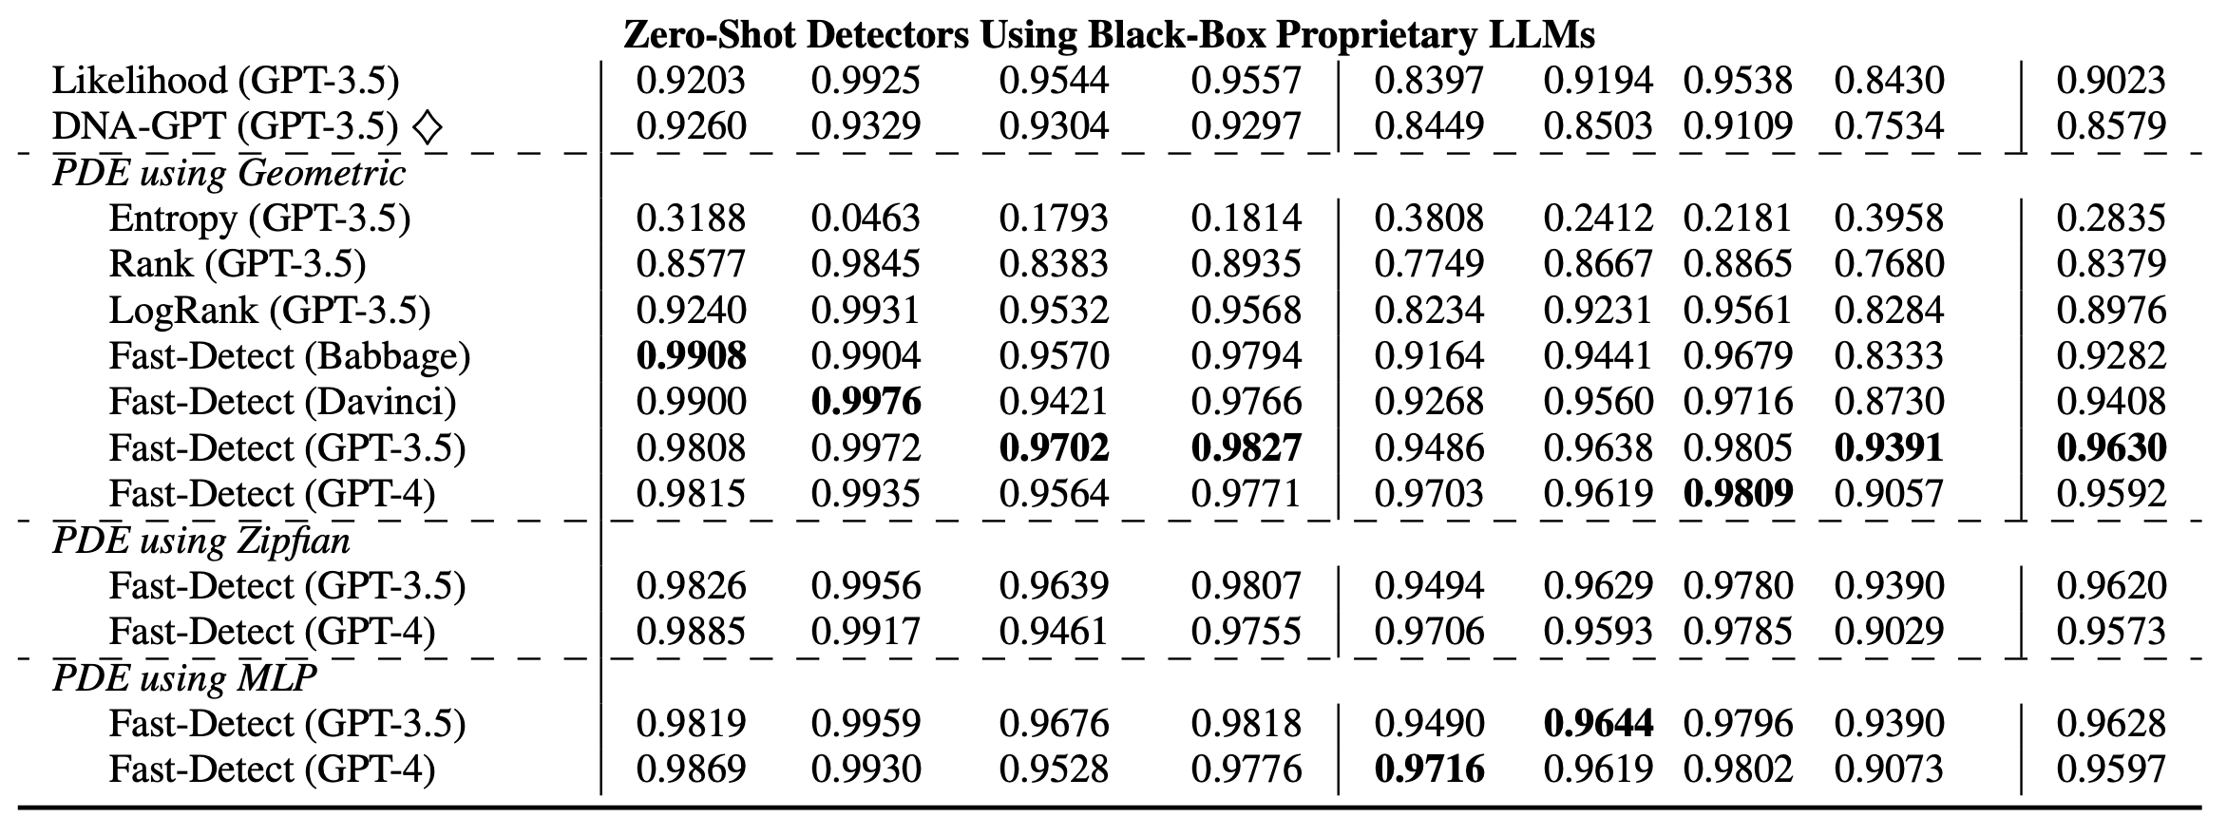
Fast-Detect + PDE
PubMed: 短文本问答
Previous SOTA

Slide 19
Advantages of PDE
Universal 通用性
Accurate and fast

Slide 20
Questions and Issues
Best way to share slides? Ideas?

